Slide 1

The European Language Resource Coordination (ELRC)
Stelios Piperidis
Institute for Language and Speech Processing / Athena R.C.
ELRC

Slide 2

The ELRC context
TRANSPORT
TELECOM
ENERGY

Slide 3

The ELRC context
TRANSPORT
CEF Digital: Digital
Service Infrastructures
eTranslation
TELECOM
ENERGY
Broadband

Slide 4



Heads & organisations behind the ELRC
The ELRC Consortium:

Slide 5

Heads & organisations behind the ELRC
30 ELRC Technological National Anchor Points
30 ELRC Public Services National Anchor Points

Slide 6
The ELRC anchor points in Bulgaria
Hristina Dobreva
Ministry of Transport, Information Technology and Communications, Information Technology Directorate
Svetla Koeva
Institute for Bulgarian Language, Bulgarian Academy of Sciences

Slide 7
What does ELRC do?
Collect
Help
Act
Engage
Identify
Language resources
Needs of public services
With the public sector in the identification of LR
With any technical or legal issues
Observatory for language resources across Europe
7

Slide 8
Why ELRC…?
To facilitate multilingual communication and exchange of information in key public service scenarios
How? With the right language resources!
Examples of public services scenarios to which eTranslation may be applied:
  Consumer Rights (ODR),
  Social Security (EESSI),
  Justice (eJustice),
  Commerce (BRIS),
  Open Data (EDP),
  …

Slide 9

Language equality in the digital age
The European Parliament voted in favor of the resolution on "Language equality in the digital age” on 11. September

Slide 10
Language equality in the digital age
“18. Calls on the Commission and the Member States to develop strategies and policy action to facilitate multilingualism in the digital market; requests, in this context, that the Commission and the Member States define the minimum language resources that all European languages should possess, such as data sets, lexicons, speech records, translation memories, annotated corpora and encyclopaedic content, in order to prevent digital extinction;”

Slide 11
Language equality in the digital age
“21. Calls on the Commission to make as a priority of language technology those Member States which are small in size and have their own language, in order to pay heed to the linguistic challenges that they face;”

Slide 12
Language equality in the digital age
Committee on Industry, Research and Energy (11.9.18): stresses "the role of the EU, the Member States, universities and other public institutions in contributing to the preservation of their languages in the digital world and in developing databases and translation technologies for all EU languages, including languages that are less widely spoken; calls for coordination between research and industry with a common objective of enhancing the digital possibilities for language translation and with open access to the data required for technological advancement".

Slide 13
Why ELRC…?
Cracking the Language Barrier Federation (2016): “We recommend that Europe actively makes an effort to compete in the global landscape for research and development in language technology since we cannot expect third parties from other continents to solve our translation and knowledge management problems in a way that suits our specific communicative, societal and cultural needs. Language Technology made for Europe in Europe is the key. It will contribute to future European crossborder and cross-language communication, economic growth and social stability.”

Slide 14
What does ELRC do?
Collect
Help
Act
Engage
Identify
Language resources
Needs of public services
With the public sector in the identification of LR
With any technical or legal issues
Observatory for language resources across Europe
14

Slide 15
How to make it work…?
With the right language resources!
Source Text
Add in-domain text
CEF AT
In-domain data
Translation
Good translation

Slide 16
How to make it work…?
In-domain data
Out-of-domain data
Your language resources make a difference!

Slide 17
What has been achieved so far…?
The ELRC network
More than 400 identified data holders
60 National Anchor Points
ELRC
consortium
Today
April 2016
April 2015

Slide 18
What has been achieved so far…?
ELRC Data in April 2017

Slide 19
What has been achieved so far…?
ELRC Data in October 2018
More than 430 LRs provided by ELRC

Slide 20
What has been achieved so far…?
ELRC Data by language

Slide 21
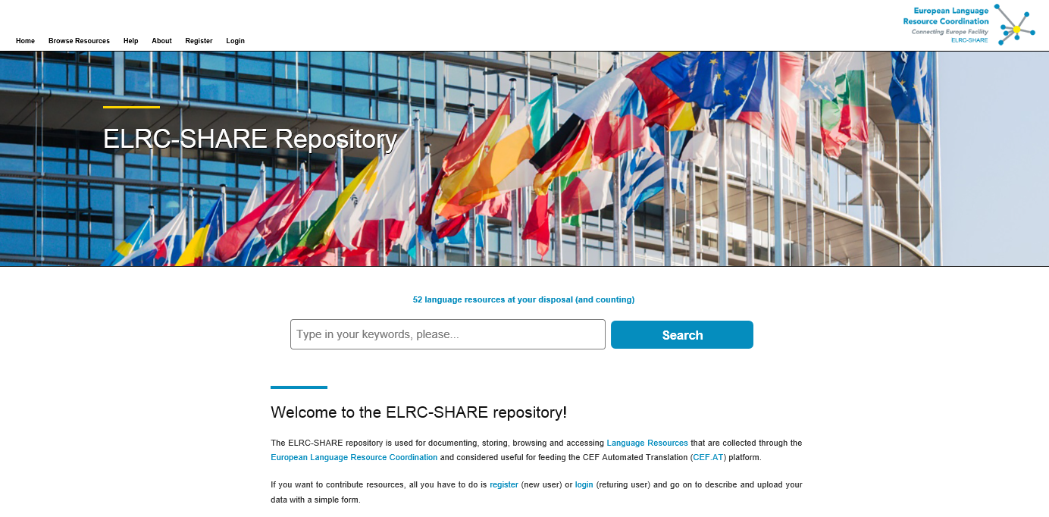
ELRC for you…
The ELRC-SHARE Repository
  Access to, sharing and contribution of language resources
  Access to tools and services catalogue (upcoming)
  Visit https://elrc-share.eu

Slide 22
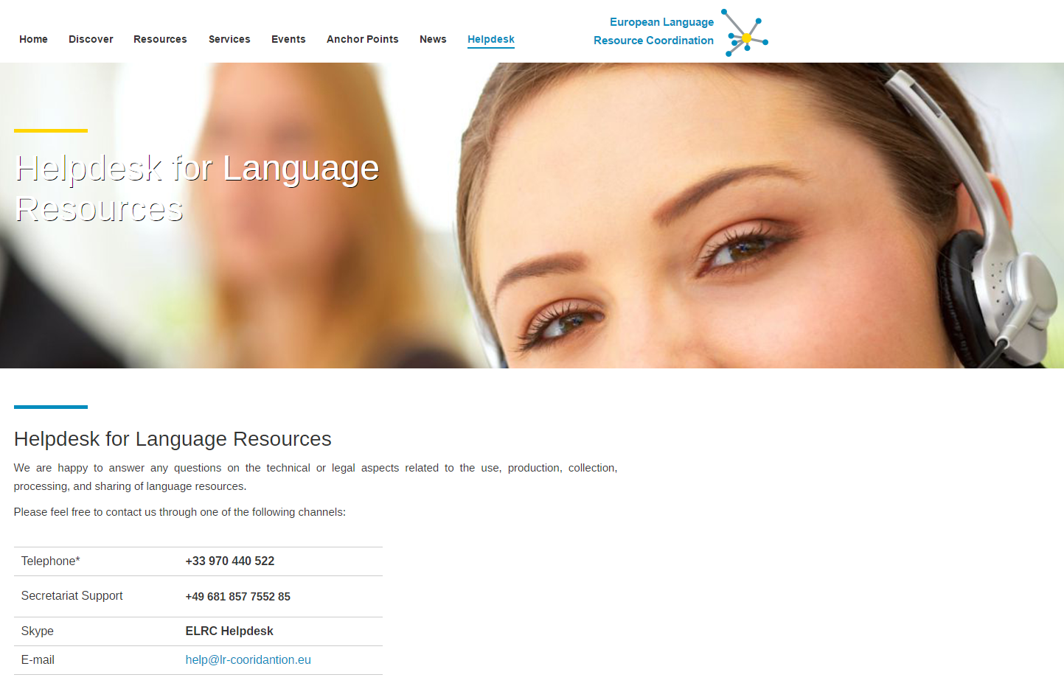
ELRC for you…
ELRC Technical and Legal Helpdesk
  Continuous support for potential data contributors (phone, email, …)
  Accessible online via http://www.lr-coordination.eu/helpdesk

Slide 23
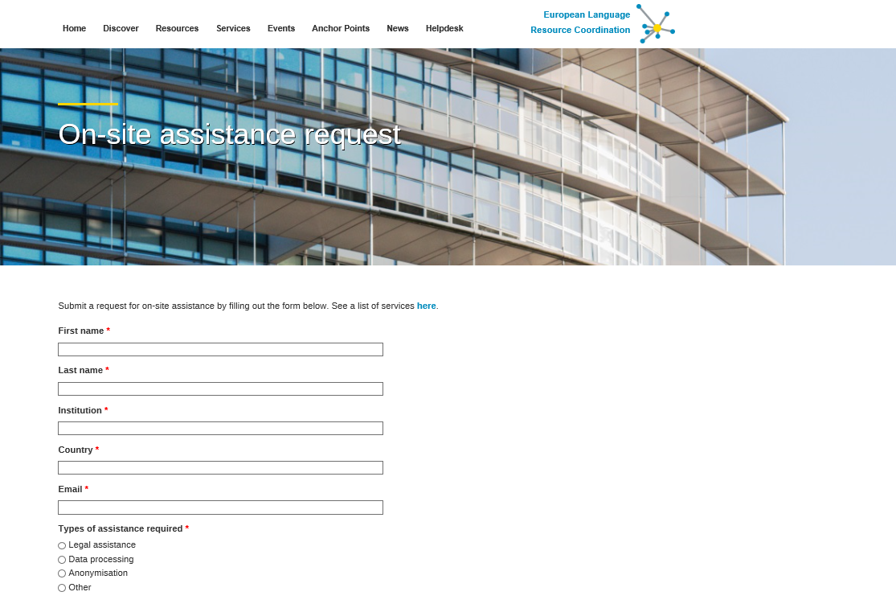
ELRC for you…
ELRC On-site assistance
  Submit request online at http://www.lr-coordination.eu/services

Slide 24
Thank you for your attention!
Email: info@lr-coordination.eu
Website: www.lr-coordination.eu

